Slide 1

KNOWLEDGE INSTITUTE OF TECHNOLOGY
Chapter 1
Introduction to Control Systems
PREPARED BY
R.RASU M.E
ASSISTANT PROFESSOR/ECE

Slide 2
Objectives
Upon completing this topic, you should know;
the fundamentals of Control System
the comparison between open loop and closed loop control schemes
the design objectives of acquiring control system

Slide 3
Introduction
Student activity 1: Brainstorming
In 1 minutes, discuss with your partner what a “Control System” is all about ?

Slide 4
Basic Component of a control system
Control System Definition
Consists of subsystems and processes/plants assembled for the purpose of controlling the outputs of the processes.
Provides an output or response for a given input or stimulus
A control system is an interconnection of components forming a system configuration that would provide a desired output in response to input signals.
Input; stimulus
Control System
Output; response
Desired response
Actual response
Basic Block Diagram of Control System

Slide 5
Control System Objectives
Control/regulate the output from some process to be constant at the required/desired value.
Make the process output follow a particular changing form.

Slide 6
Advantages of Control System
We build control systems for four primary reasons:
-Power amplification - e.g. radar antenna position
-Remote control - e.g. robots in contaminated areas
-Convenience of input form - e.g. temperature control system
-Compensation for disturbances - e.g. antenna position in the presence of strong wind
In addition, we can
move large equipment with precision
point huge antennas toward the farthest reaches of universe to pick up faint radio signals

Slide 7
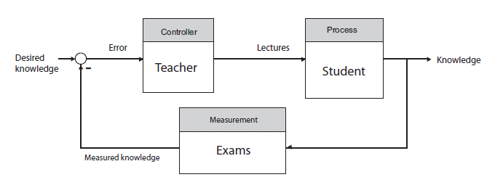
Some Examples Of Control System Applications
The student-teacher learning process.

Slide 8
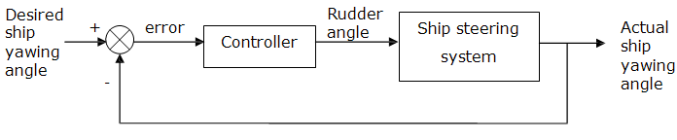
Modern ship uses electrical, mechanical and hydraulic components to develop rudder commands in response to desired heading commands to steer the ship.
Simplified block diagram of a ship steering control

Slide 9
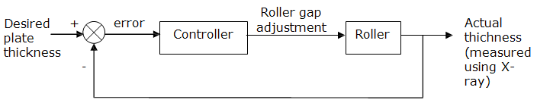
Thickness control system for a steel plate finishing mill.
Steel plate thickness control system

Slide 10
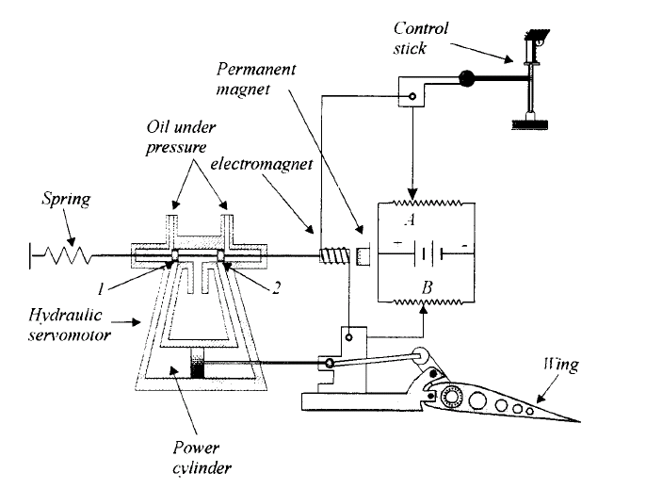
Aircraft wing control system.

Slide 11
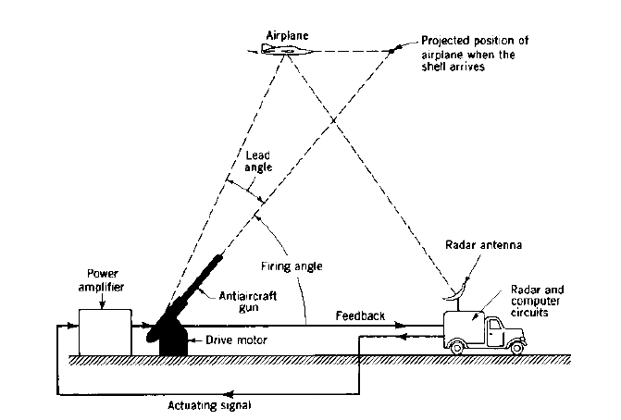
Anti-aircraft radar-tracking control system.

Slide 12
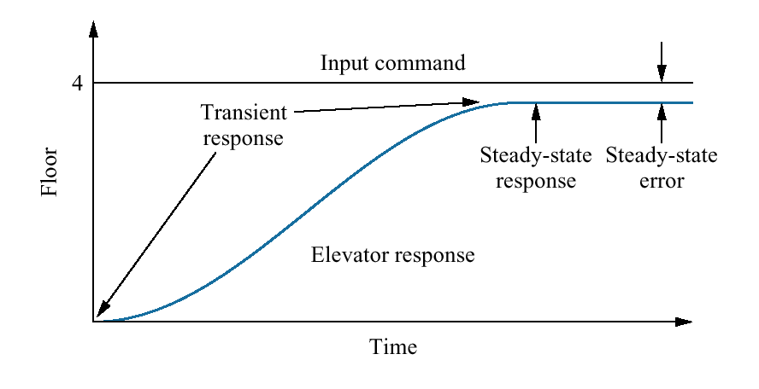
Response Characteristics
A control system responses to an input by undergoing a transient response, before reaching a steady state.
Response characteristic – input, output, transient response, steady-state response and steady-state error
desired response
gradual change before the steady state response
Actual response
differences between input and output

Slide 13
Response Characteristics
Input/stimulus – a desired response
Output – the actual response
Transient response – a gradual change from one steady state to another when there are changes in the input
Steady-state response – a state after transient component settle down
  Only exists for a stable system
Steady-state error – the differences between input and output

Slide 14
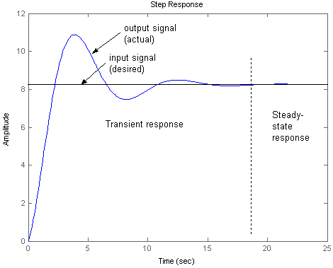
A typical response of a system to a step input.

Slide 15
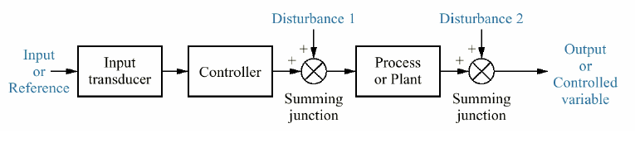
System Configurations: i) Open-loop Control System(OLCS)
The output signal of OLCS is not fed back to influence the control action
The control action of an OLCS depends only on the input signal
OLCS are not capable of filtering disturbances or noise
OLCS are suitable when input signal for satisfactory system performance can be estimated/approximated and does not change
Advantages of OLCS are that its structure is simple compared to a closed loop control system and is cheaper to build.

Slide 16
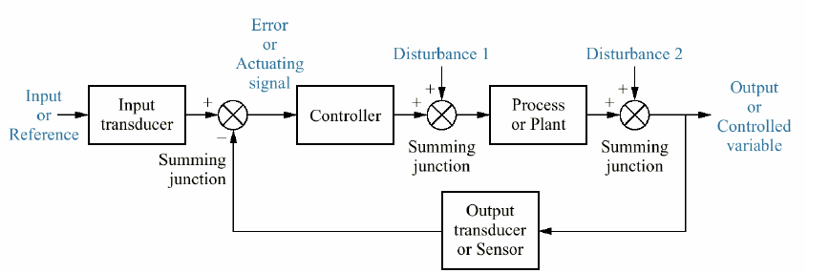
ii) Closed-loop Control System(CLCS)
The output signal of a CLCS is fed back to influence the control action and improve the overall system performance
Examples: robot arms, velocity control systems, temperature control systems
However, in practical, a combination of both OLCS and CLCS is normally used. For example, washing machine: the process of filling up the tank with water is a CLCS operation, while the process of washing and rinsing is an OLCS operation

Slide 17
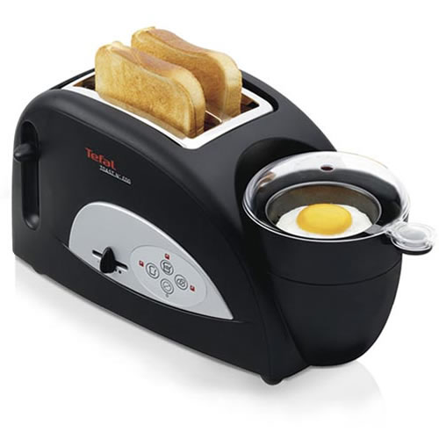
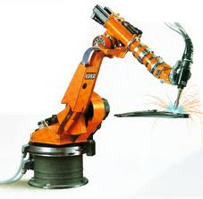
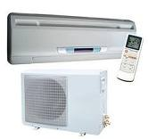
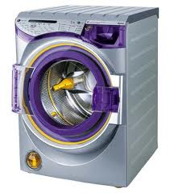
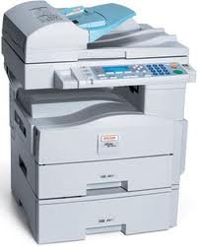
Decide OLCS @ CLCS
CLCS
OLCS
OLCS & CLCS
CLCS
Try draw the block diagram of the systems
OLCS

Slide 18
OLCS vs CLCS
Type of System | Advantages | Disadvantages | Examples
OLCS | Simple construction and ease of maintenance. Less expensive than a corresponding closed-loop control system There is no stability problem Convenient when output is hard to measure or measuring the output precisely is economically not feasible | The system response very sensitive to external disturbance and internal variations in system parameters. Recalibration is necessary from time to time in order to maintain the required quality in the output | Toaster Rice cooker Electric fan Photocopy machine
CLCS | insensitive to external disturbance and internal variations in system parameters. Possible to use relatively inaccurate and inexpensive components to obtain the accurate control of a given plant. Better control of transient & steady-state response Increased accuracy Increased ability to reproduce output with varied input | Risk instability Complexity in analysis and implementation and expensive | Positioning CS (robot arms) Velocity CS (vehicles cruise system) Temperature CS (Air-conditioner)

Slide 19
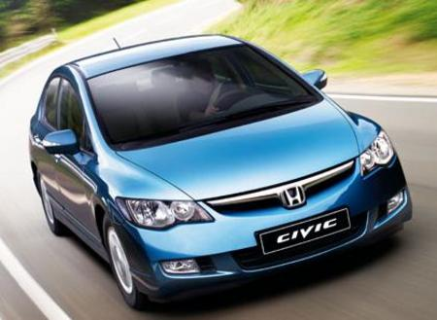
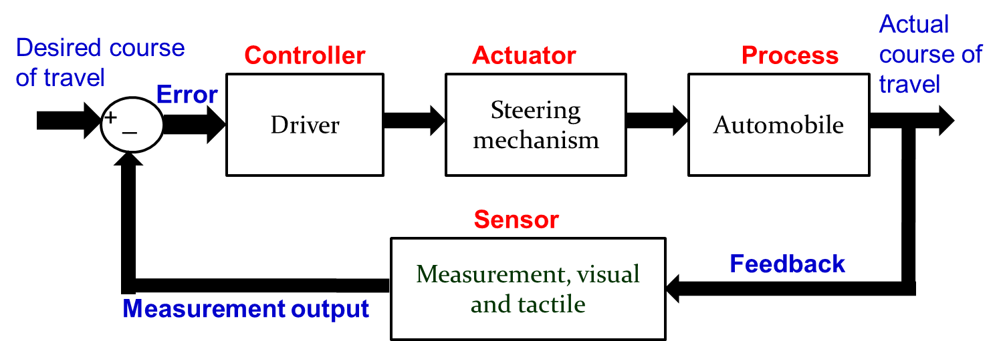
Example 1
Steering a car on a curve road
Discuss how to control a car when driving
on a curve road??
Desired direction
Actual direction
Block Diagram

Slide 20
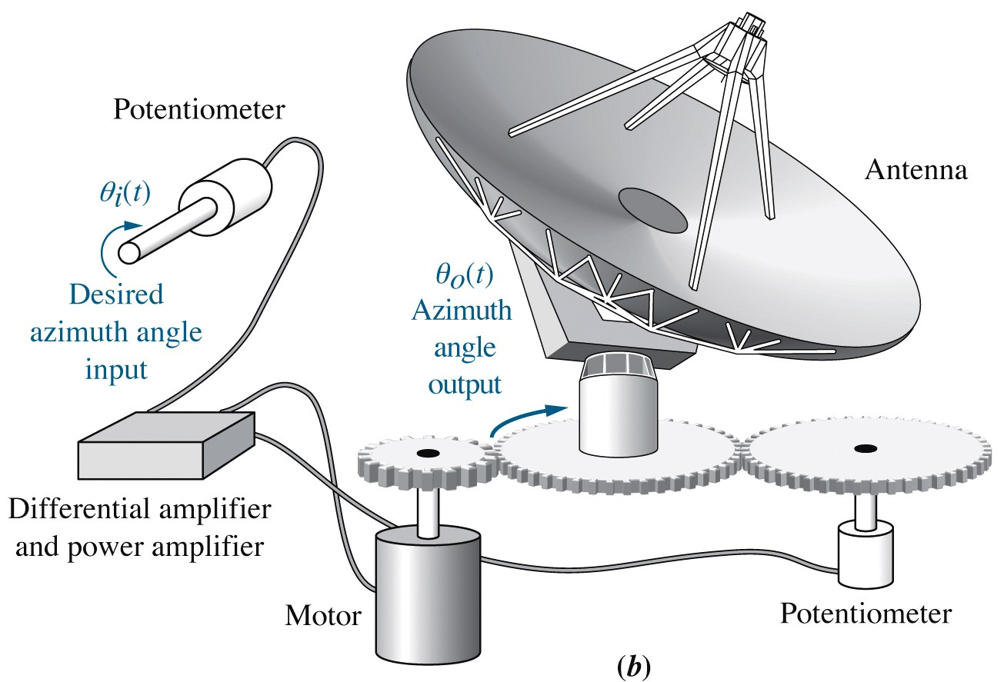
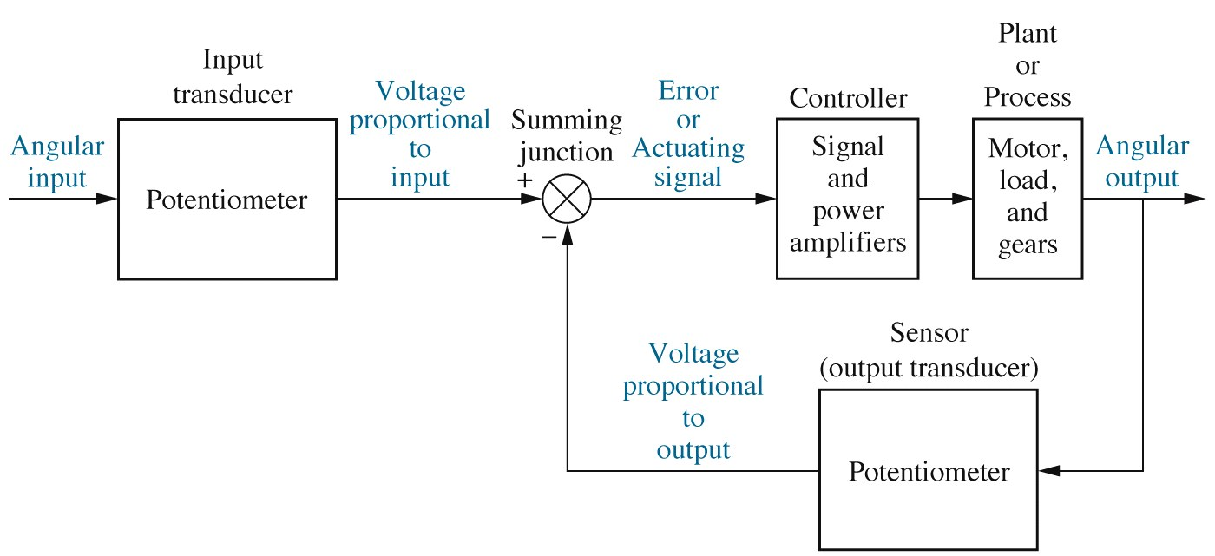
Example 2
Input
Output
Sensor
Block Diagram
Controller
Plant

Slide 21
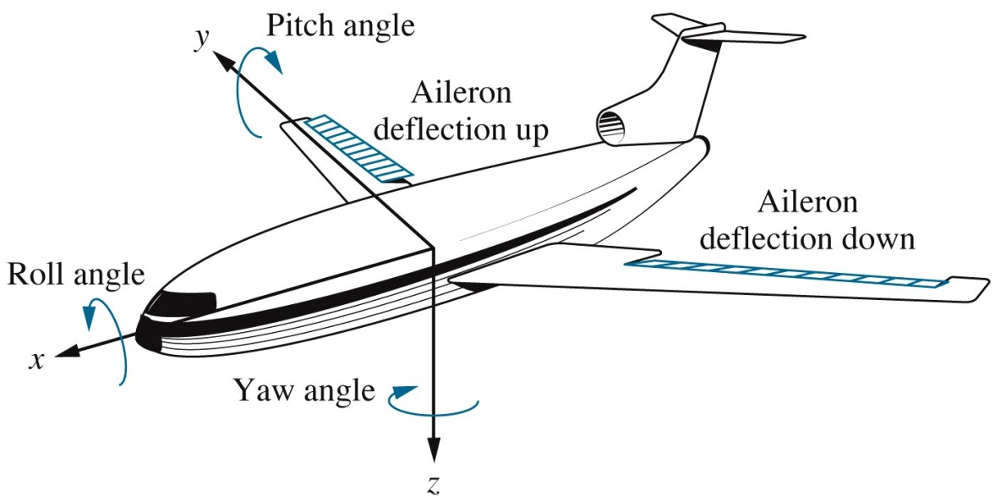
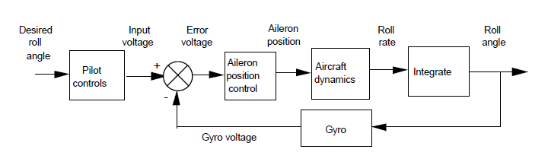
Example 3
Input
Controller
Pilot
Gyro
Sensor
Plant
Output

Slide 22
Lets see some animation on control system!!

Slide 23
Analysis And Design Objectives
Control systems are dynamic : they response to an input by undergoing a transient response before reaching steady-state response that generally resembles the input.
3 major objectives:-
  Producing the desired transient response
  Reducing steady-state error
  Achieving stability

Slide 24
Analysis And Design Objectives
Three major objectives:
1
Producing the desired transient response
2
Reducing steady-state error
3
Achieving stability

Slide 25
Analysis And Design Objectives
i) Producing the desired transient response. Transient response is the case when the plant is changing from one steady state to another, when there are change in the input signal; example: elevator
ii) Reducing steady state error. Steady state response only exist for stable system. An important characteristic for design is the steady state error. Example an elevator that does not stop at the same level at the floor may cause serious accident to its passengers.
iii) Achieving stability: A system that can produce a consistent/steady output is a stable system. An unstable system is harmful to the plant and may cause serious accidents.

Slide 26
Analysis And Design Objectives
Transient Response
Important in control system
E.g. In the case of an elevator, a slow transient makes passenger impatient, whereas an excessively rapid response makes them uncomfortable.
Too fast a transient response could cause permanent physical damage.
Therefore, we have to analyze the system for its existing transient response.
Then, adjust parameters or design components to yield a desired transient response.

Slide 27
Analysis And Design Objectives
Steady-State Response
This response resembles the input and is usually what remains after the transients have decayed to zero.
We define steady-state errors quantitatively,
Analyze a system’s steady-state error, and then
Design corrective action to reduce this error.

Slide 28
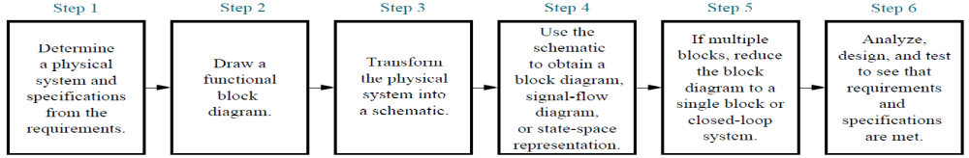
The Design Process
The design of a control system follows these steps:

Slide 29
Computer Aided Design (CAD)
Using computer, we can perform analysis, design and simulation with one program.
With the ability to simulate a design rapidly, we can easily make changes and immediately test a new design.
In this subject, we use ScicosLAb for CAD.

Slide 30



